Slide 1
Sudoku with multiplayer by LAN
Kh.Serikjan, B.Batkhuu IT3-1

Slide 2

Useful sides of program
Lots of people like playing games.
When you have a human opponent it becomes more interesting.
Improve your IQ
while doing what you like.

Slide 3
Difference & Limitation
It is a game that improves people’s intellection.
Multiplayer is new option for Sudoku. (other Sudoku).
Only 2 players can play by LAN.

Slide 4
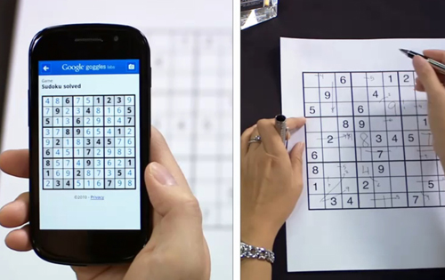
Helping people
Sudoku Olympiad.
Olympiad only checks the time or solution of person. Making competitors playing with each other can be other way of grading the winner.

Slide 5
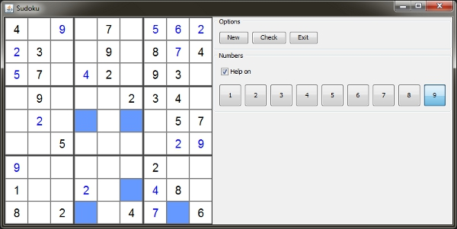
Design decision
Each player can see the opponent’s board.
Input options: Mouse and keyboard. Other Sudoku uses only mouse for input.

